Slide 1

Brownie Promise Escape Room

Slide 2

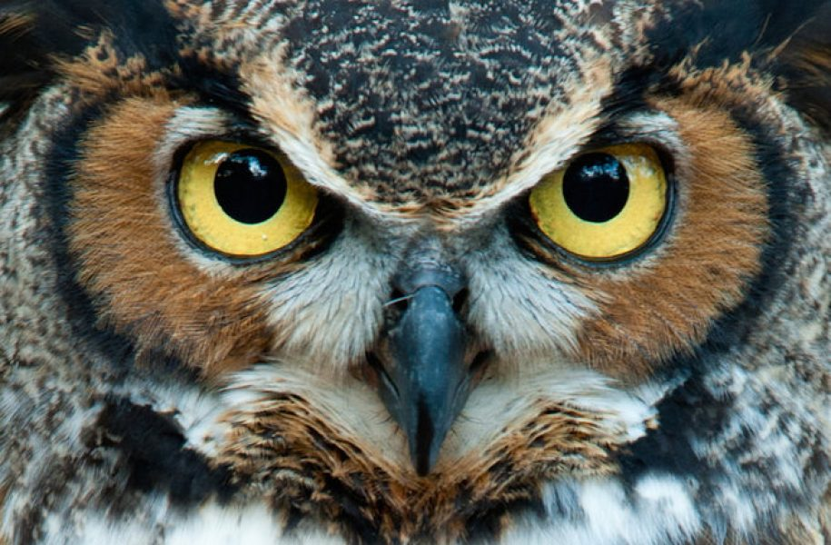
ARE YOU PREPARED?
In every challenge, look out for the wise owl who helped the Brownies through the original story.

Slide 3
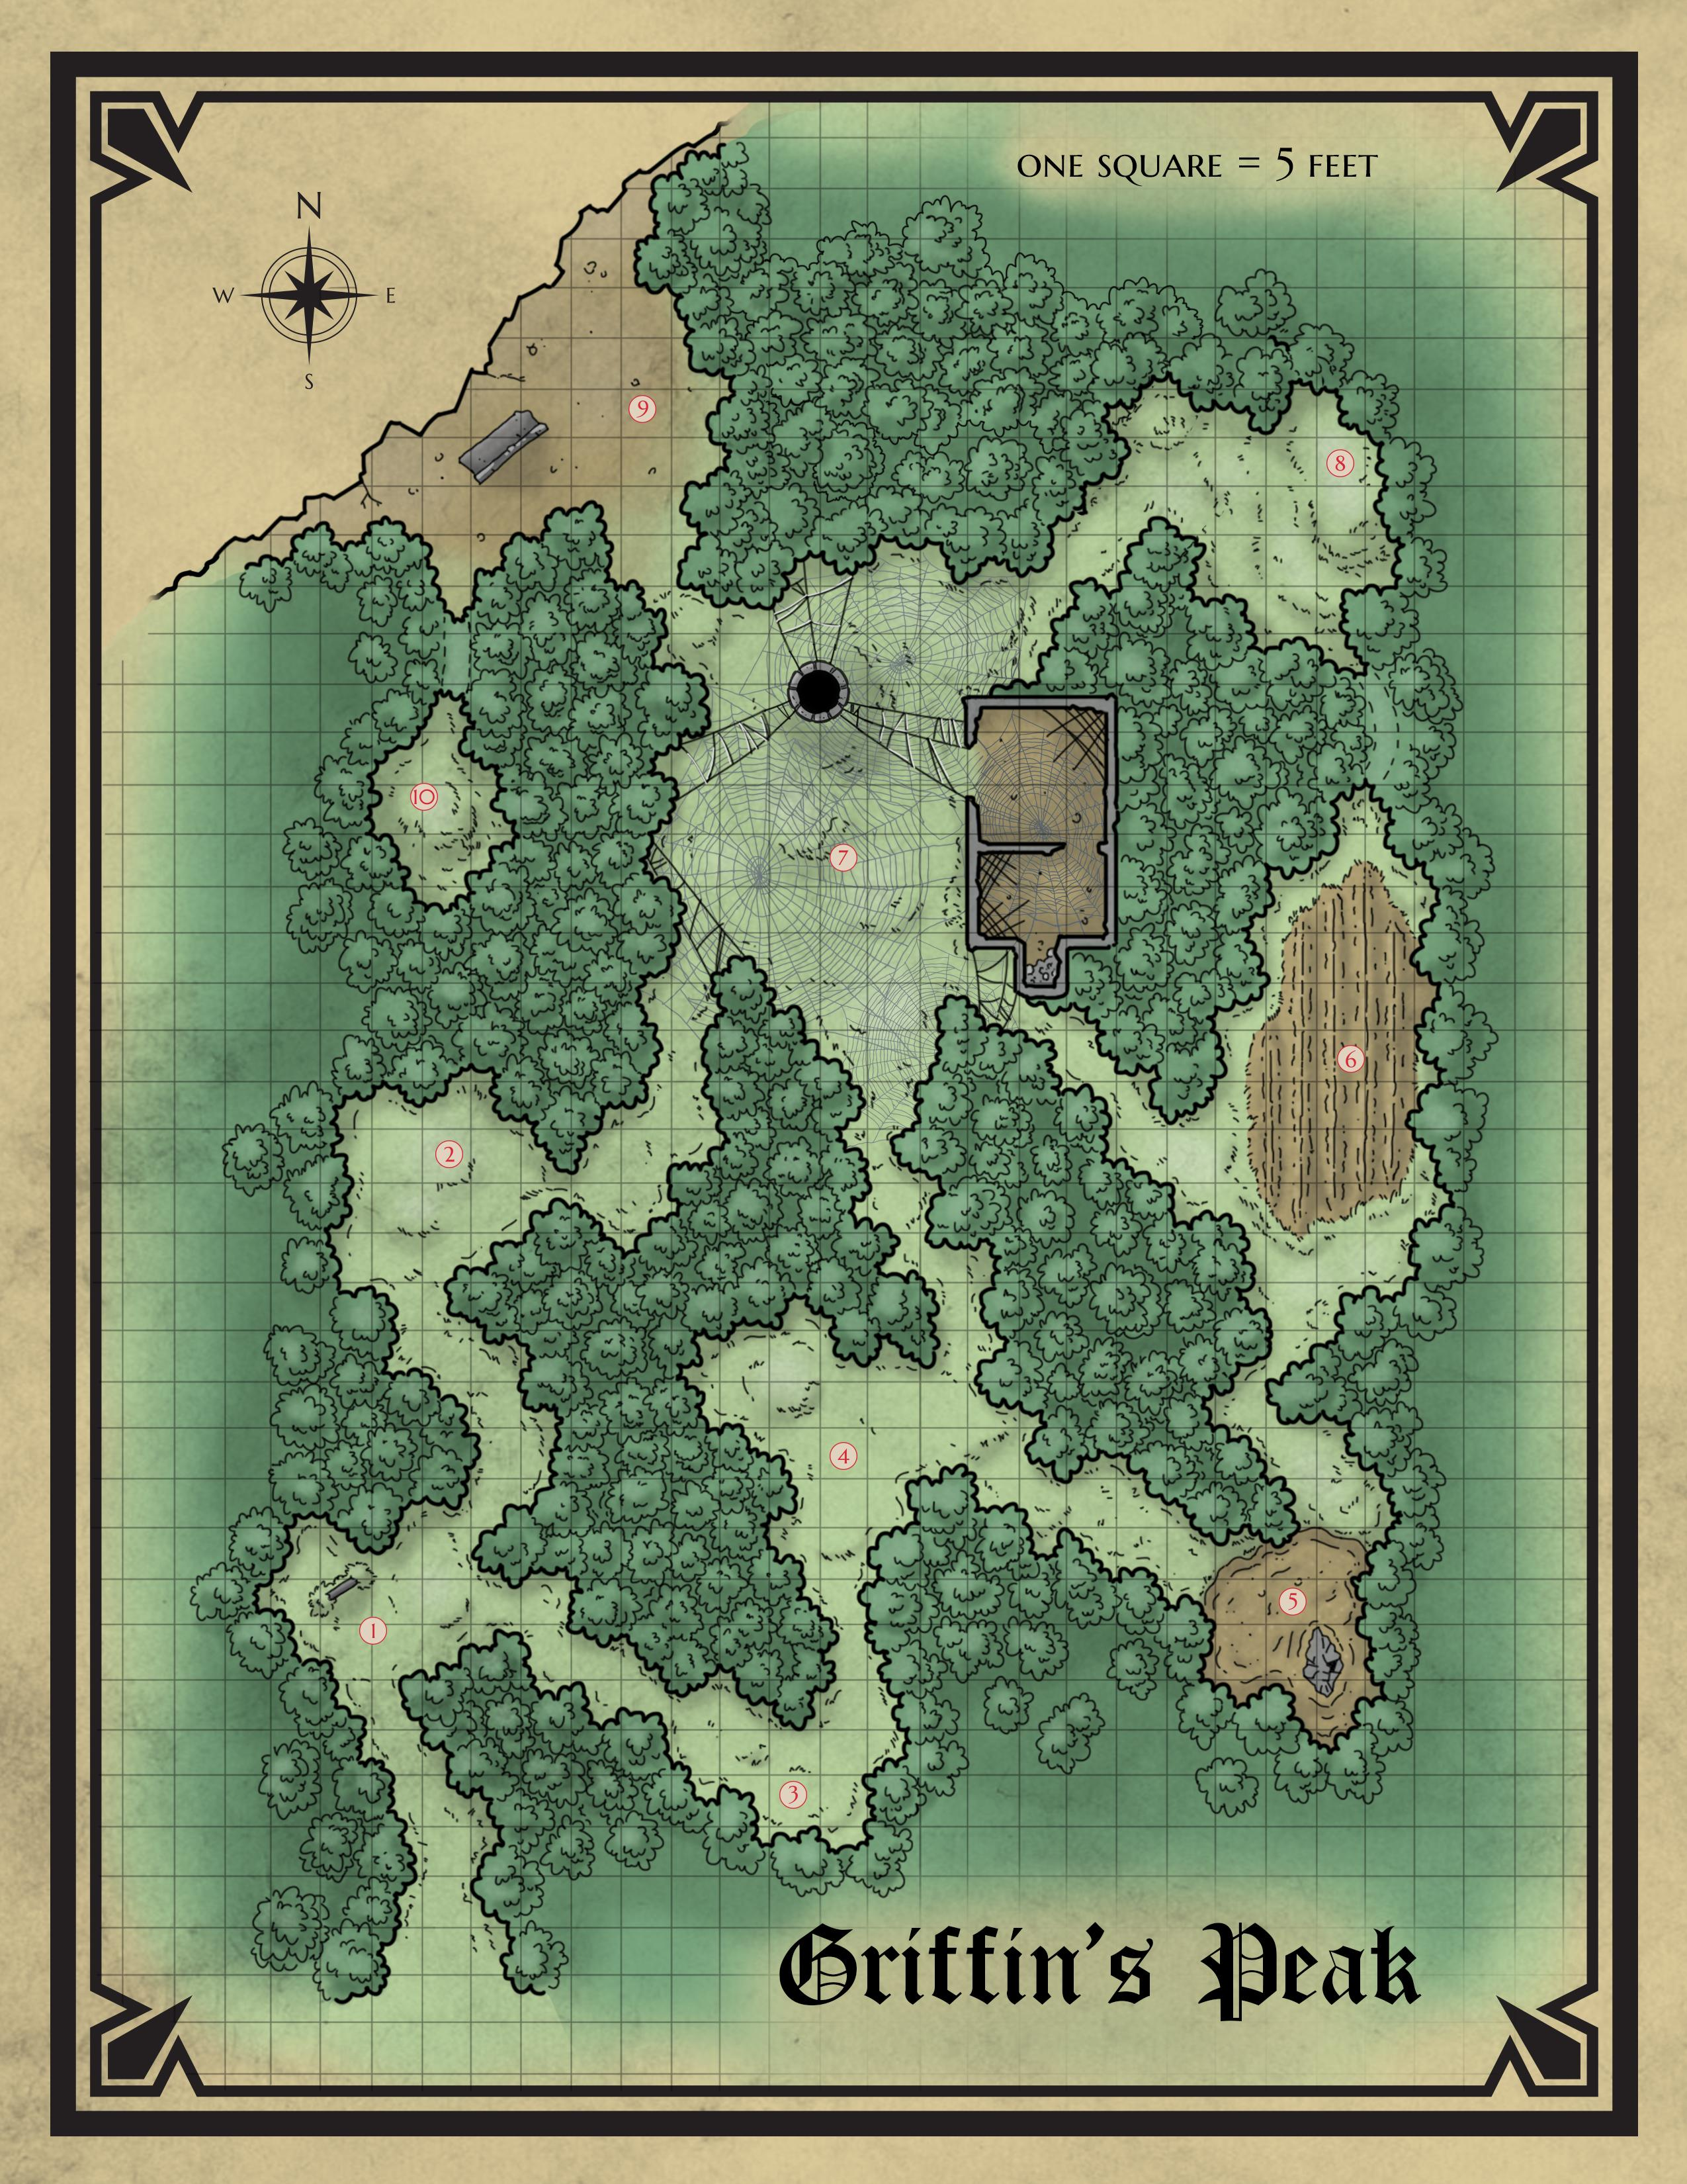

Brownie Wood

Slide 4
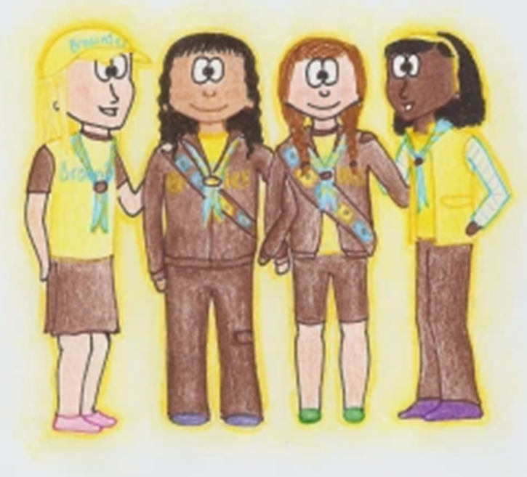
Brownies, your challenge is simple. You need to work your way through the Brownie story to get to the end.
You do this by completing puzzles and thinking about what it means to be a Brownie. You need to work together and help each other.

Slide 5
Brownie Wood

Slide 6
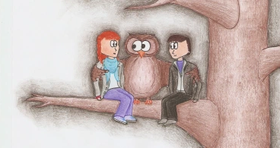
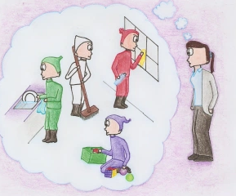
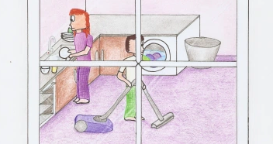
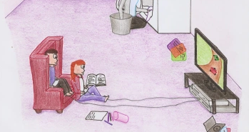
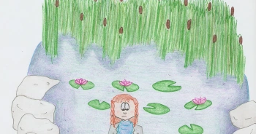
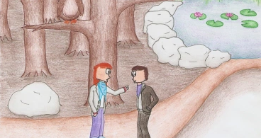
Order the pictures & tell the Brownie story

Slide 7
Brownie Wood

Slide 8
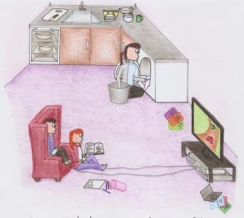
What does it mean to do ‘a good turn’?
Name 7 good turns you have done over the last week.

Slide 9
Brownie Wood

Slide 10

Let’s think about Brownies…
Find 7 things in your house that match the following. Something that (you):
1. Being a Brownie is
2. Really miss from in person meetings
3. Only do ‘cos you have to
4. Want to do next term
5. (K)Now you’re super at
6. Inspired by this term
7. Enjoy about Brownies generally

Slide 11
Brownie Wood

Slide 12

Brown Owl’s Special Challenge Time!
Can she put the cube together in under 2 minutes?

Slide 13
Brownie Wood

Slide 14
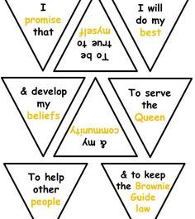

What is the Brownie promise?

Slide 15
Brownie Wood

Slide 16
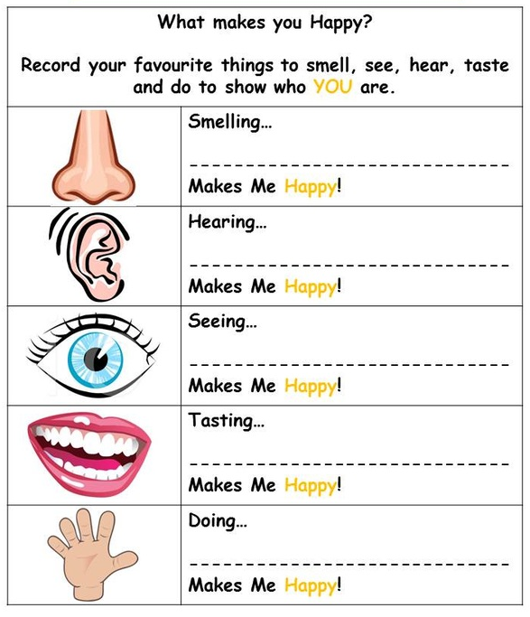
What does it mean to be true to myself?

Slide 17
Brownie Wood

Slide 18
Brownies’ Special Challenge Time!
Can you put the Queen back together in under 2 minutes?

Slide 19
Brownie Wood

Slide 20

What’s the Brownie salute?
What does it mean?
Honour God
Honour others
Keep the BP law
Peaceful hand

Slide 21
Brownie Wood

Slide 22
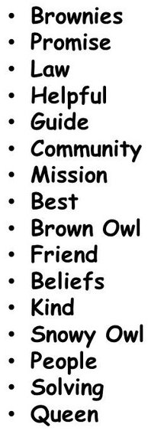
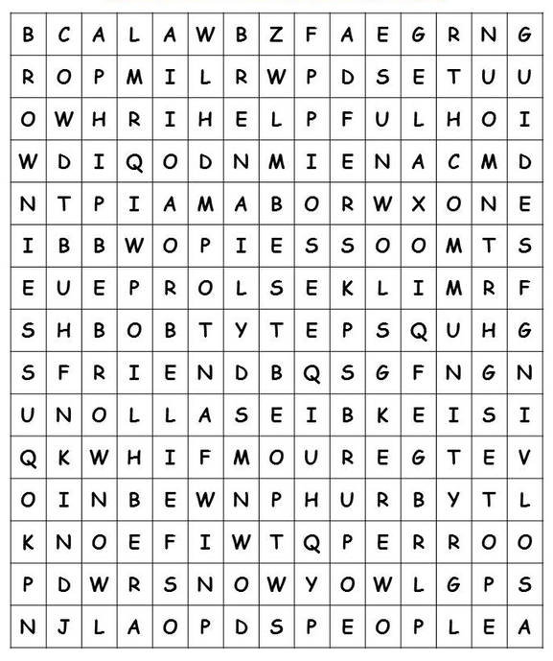
Promise Challenge Time!
Competition time! Brownies, can you find the words quicker than Brown Owl can use them all in a sentence or two?
The winner can make their promise first!

Slide 23
Promise Challenge Solution!
Brownie Guides are helpful, kind, good at problem solving and helping other people in the community, and they're a good friend.
Brown Owl's and Snowy Owl's (Pixie Owl's for us) mission is teach us how to be the best, learn more about our beliefs, respect the Queen, keep the promise and the law.

Slide 24
Brownie Wood

Slide 25
SOLVED!
☺☺☺☺☺

Slide 26

Reward One:
Brownie Promise
I promise that I will: do my best; to be true to myself and develop my beliefs; to serve the Queen and my community; to help other people; and to keep the Brownie Guide law.

Slide 27
Reward Two:
Brownie Law
A Brownie Guide thinks of others before herself and does a good turn every day.

Slide 28

Reward Three:
(Virtual) Promise Party

Slide 29
Thanks to…
1st Netley Marsh Brownies for the mini Brownie: http://1stnetleymarshbrownies.btck.co.uk/TheBrowniePromise
Griffin’s Peak for the map of the forest:
https://www.reddit.com/r/battlemaps/comments/90hvei/griffins_peak_a_fantasy_forest_map/
Adam Eschborn for the 3-minute timer:
https://www.youtube.com/watch?v=iHdviZkM7S4
Epic Moments for the 1-minute timer: https://www.youtube.com/watch?v=r9jQBN4Dfug
Lucy Barker for the animated Brownie story:
https://lucyscolouredpencils.wordpress.com/2014/08/17/the-brownie-story/#jp-carousel-99
2nd Kingsbridge Guides for the Promise Flextangle: http://2ndkingsbridgeguides.org.uk/promise-and-law-resources/4582046636
Twinkle Owl for the Brownies Mission Promise Challenge:
http://talesfromtwinkleowl.weebly.com/mission-promise-brownies.html
Celebration (Kool and the Gang) for the celebration video:
https://www.youtube.com/watch?v=8Lu41LulQos

